Slide 1
STEM High Altitude Balloon Launch

Slide 2
4/21 launch Videos and Pictures
NWHS Highlight video https://vimeo.com/statefarmhq
NCHS Balloon Burst 360 slowmo https://vimeo.com/statefarmhq
NCHS time lapse video https://vimeo.com/822099456
NCHS Insta360 video https://youtu.be/GE7wcSeM3zs

Slide 3
Telemetry analysis
4/21 NWHS Notebooks
https://github.com/StateFarm-STEM/hablogger/tree/main/telemetry-analysis/flights/normalwesths-2023-04-21

Slide 4
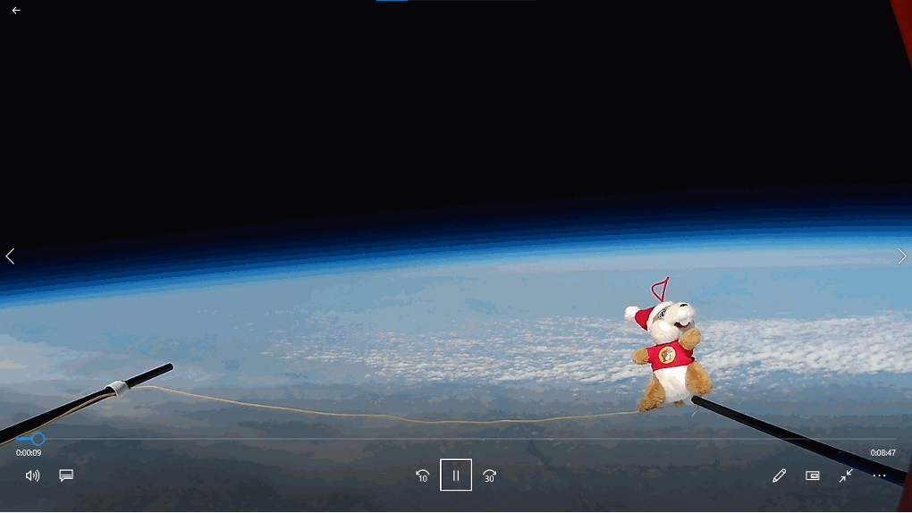

Slide 5
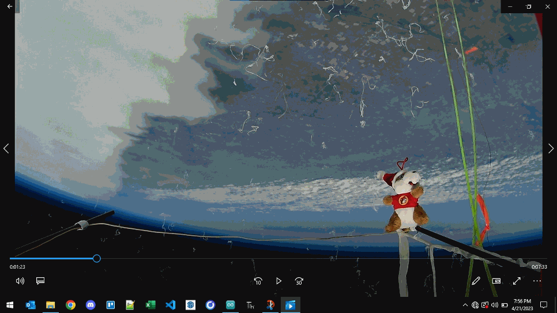

Slide 6
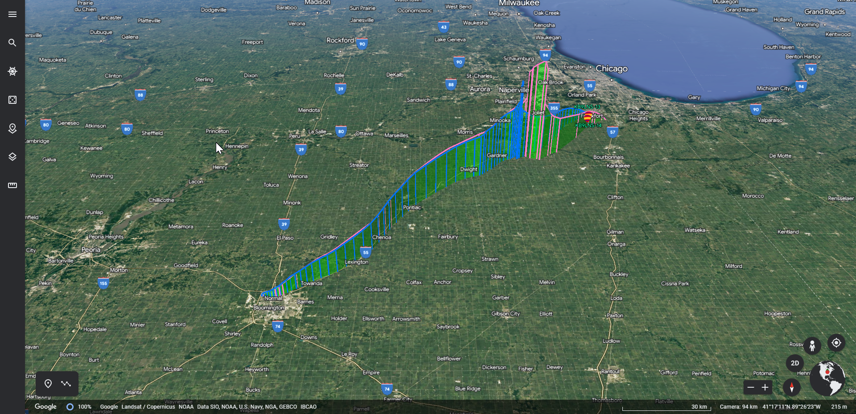

Slide 7
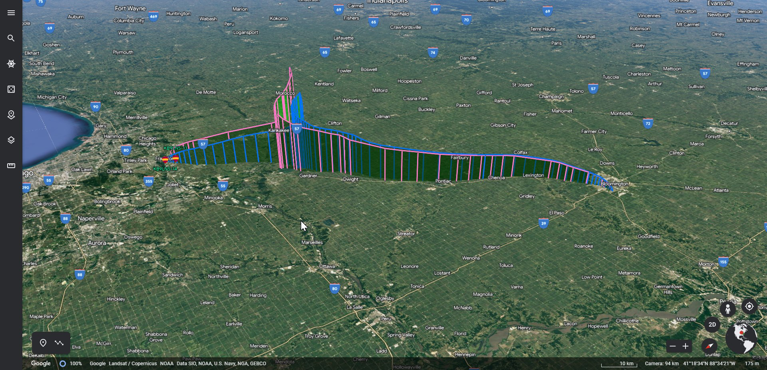

Slide 8
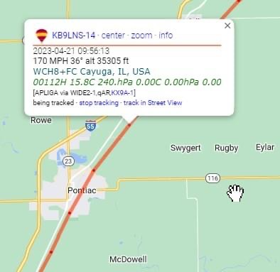

Slide 9
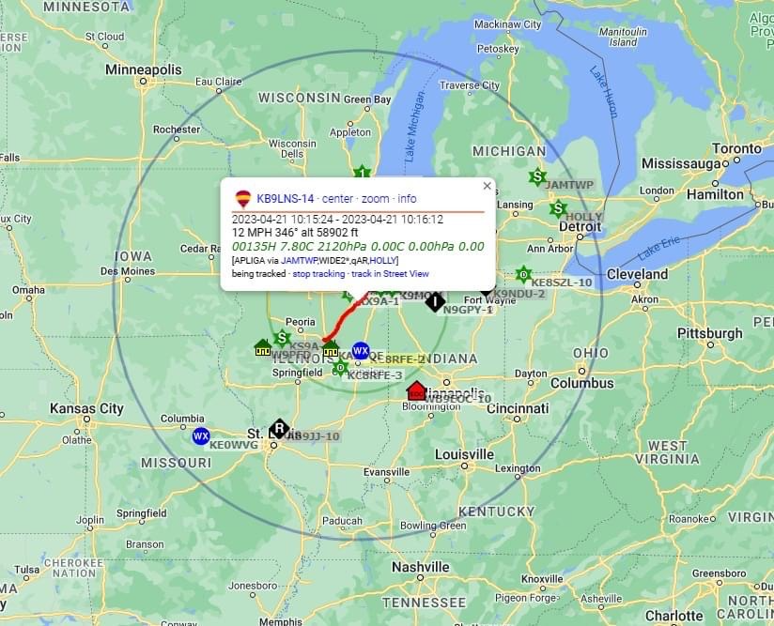

Slide 10
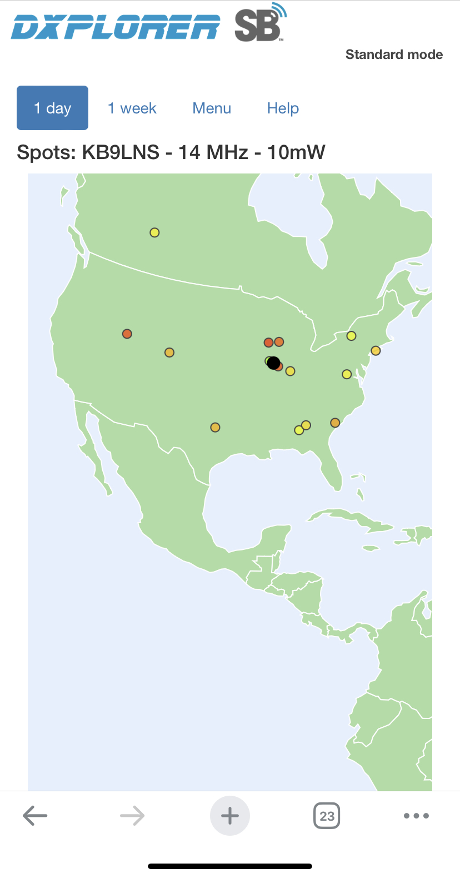
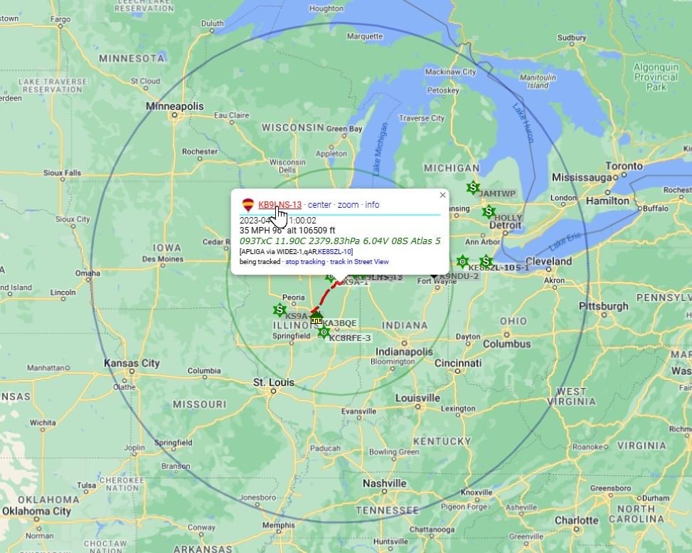

Slide 11
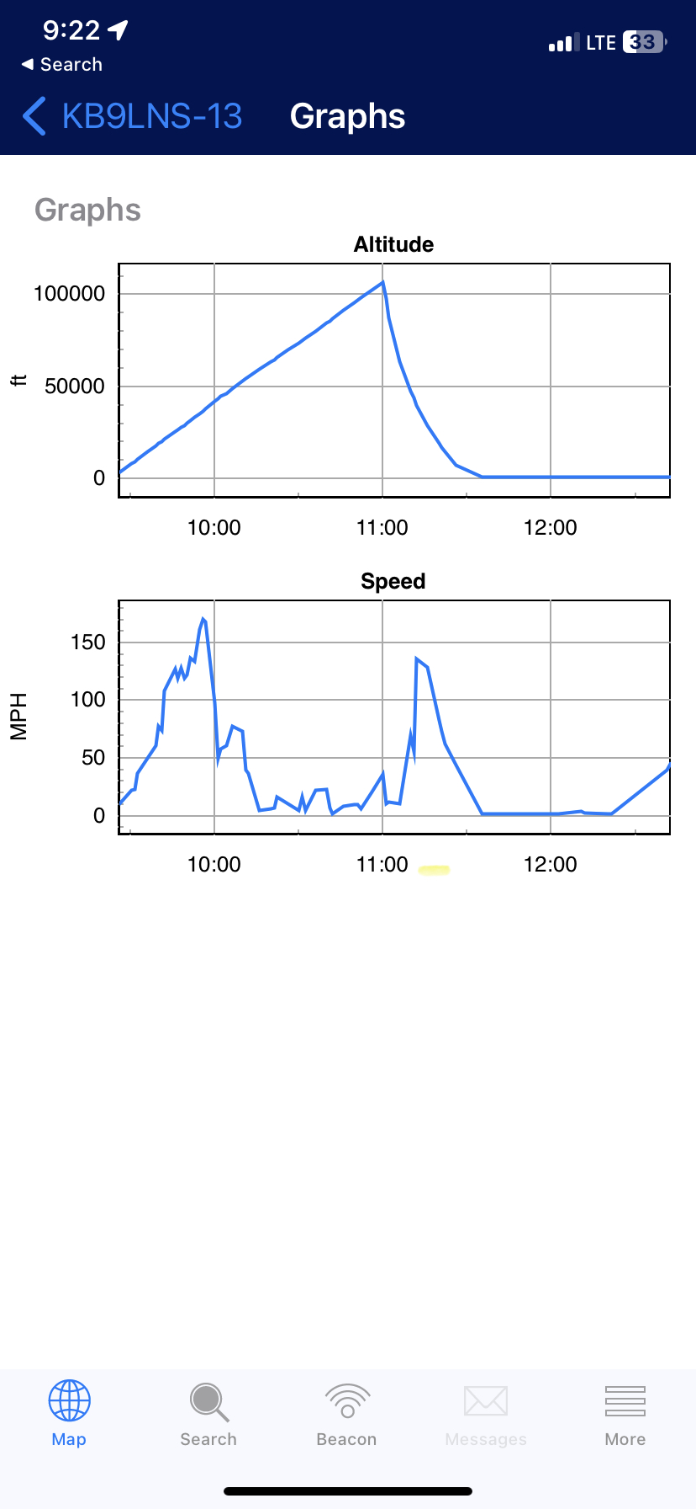
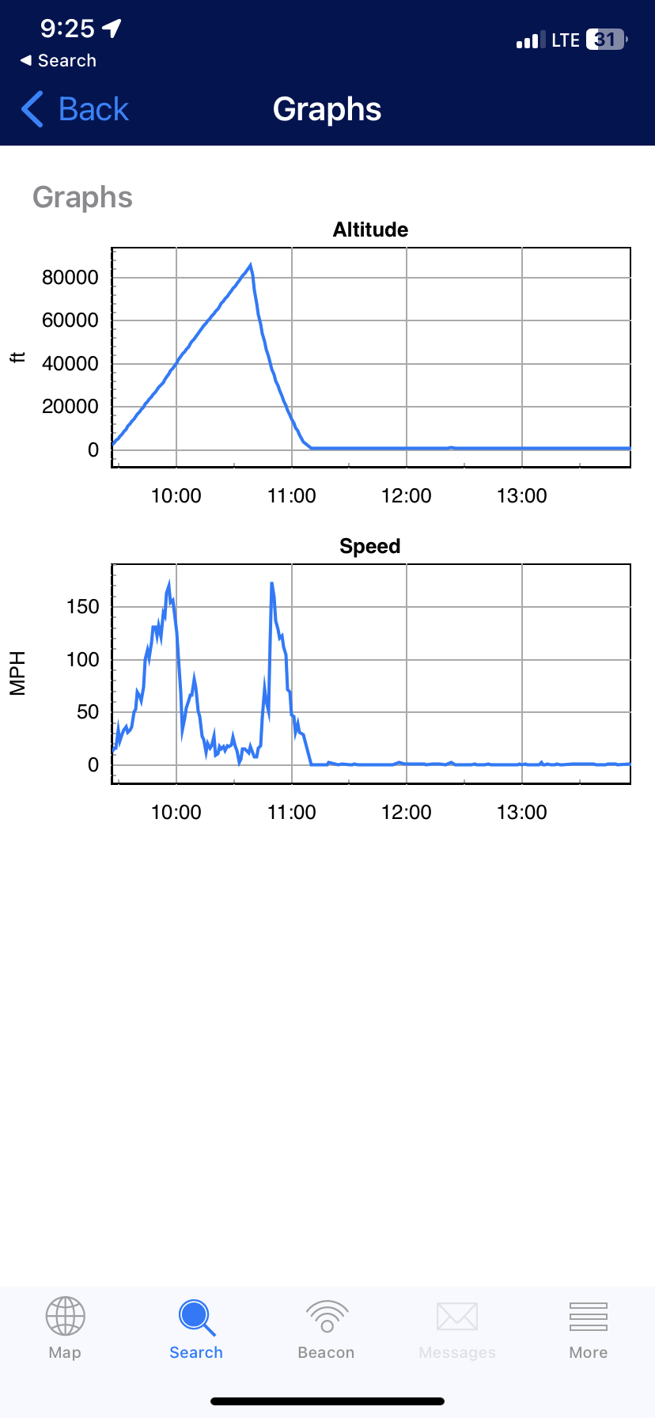

Slide 12
Lessons Learned
What did you enjoy most
What would you change
What would you have liked to see more of
What would you have liked to see less of
Did this help you apply coding?
Is coding in your future?

